Slide 1




Slide 2





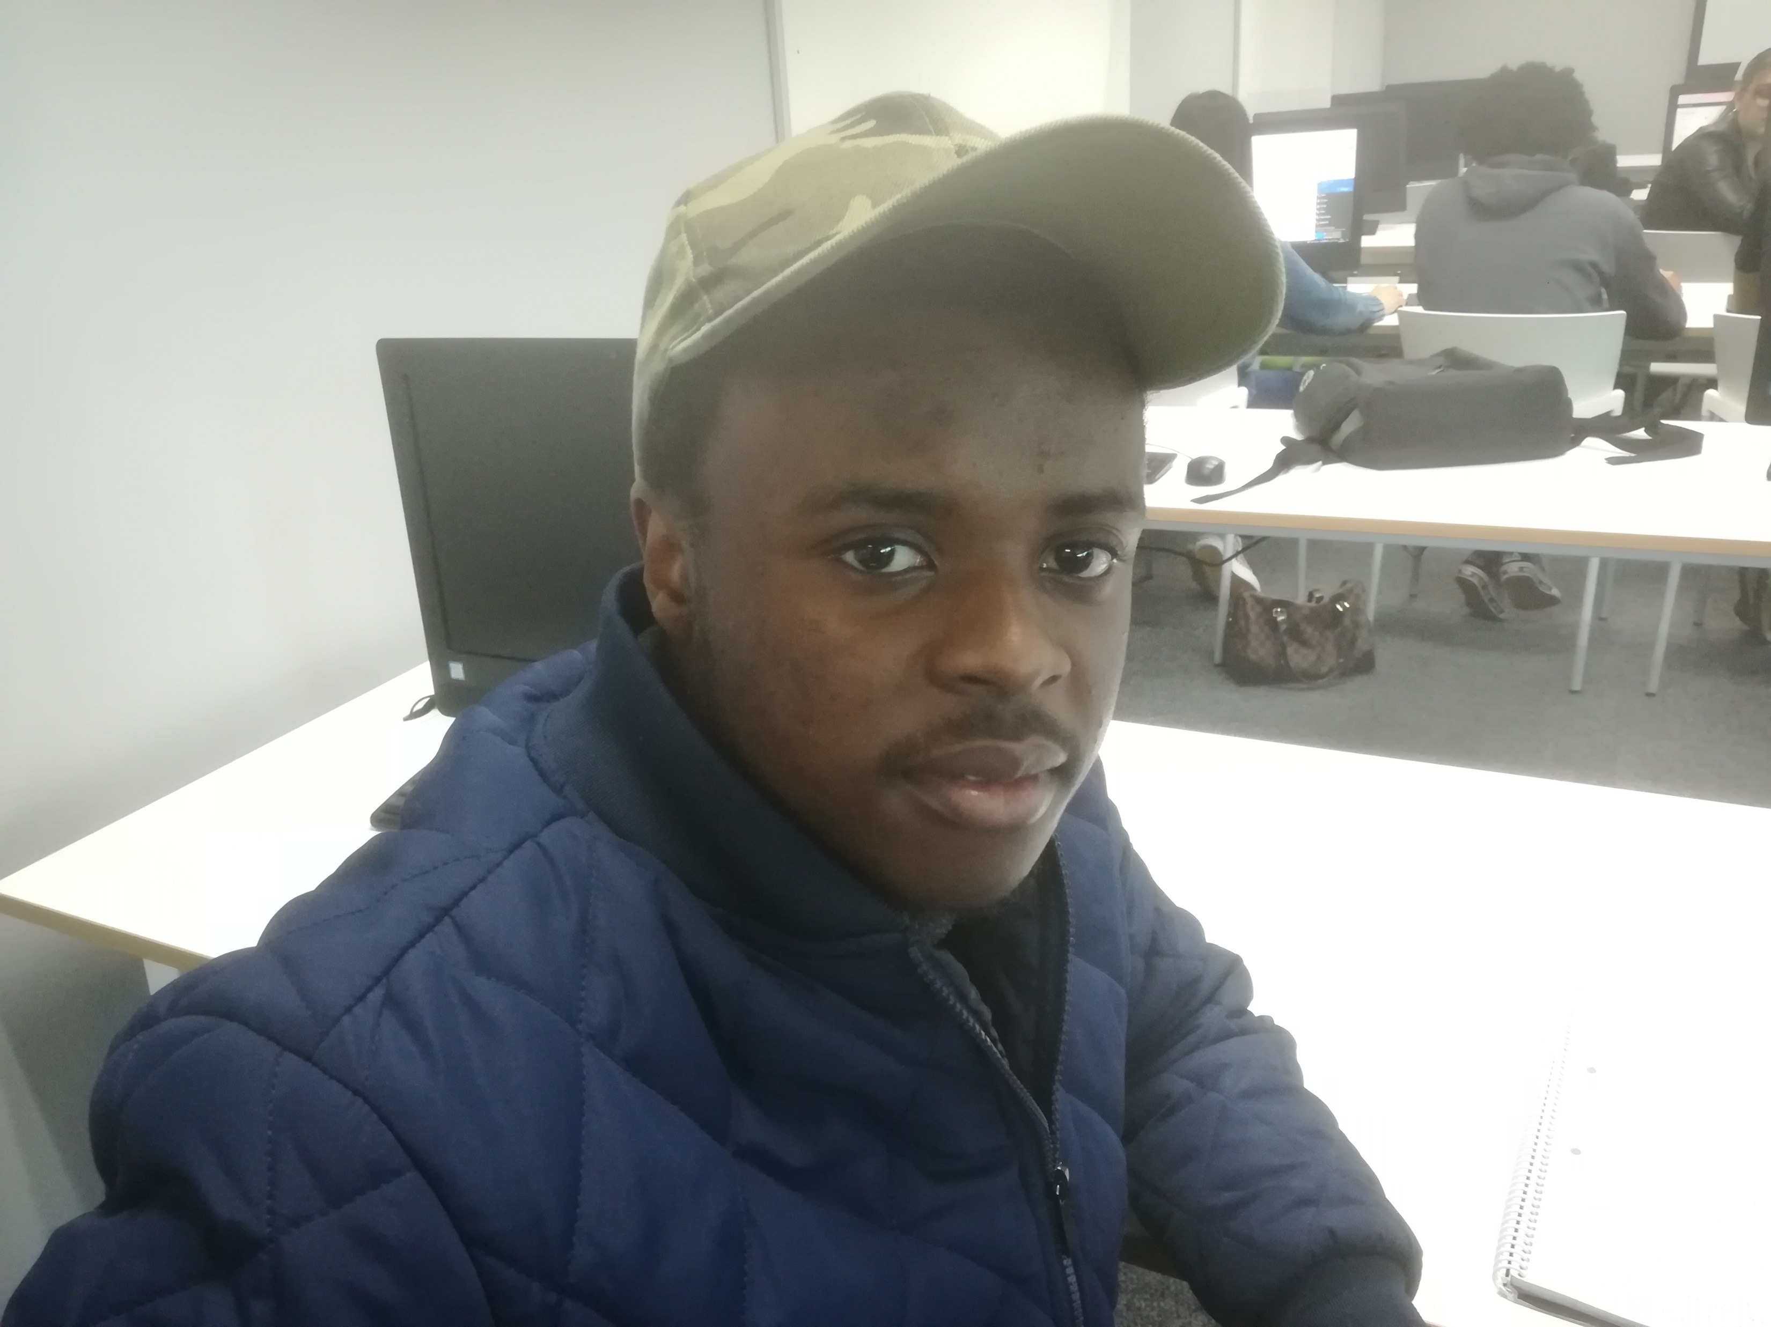
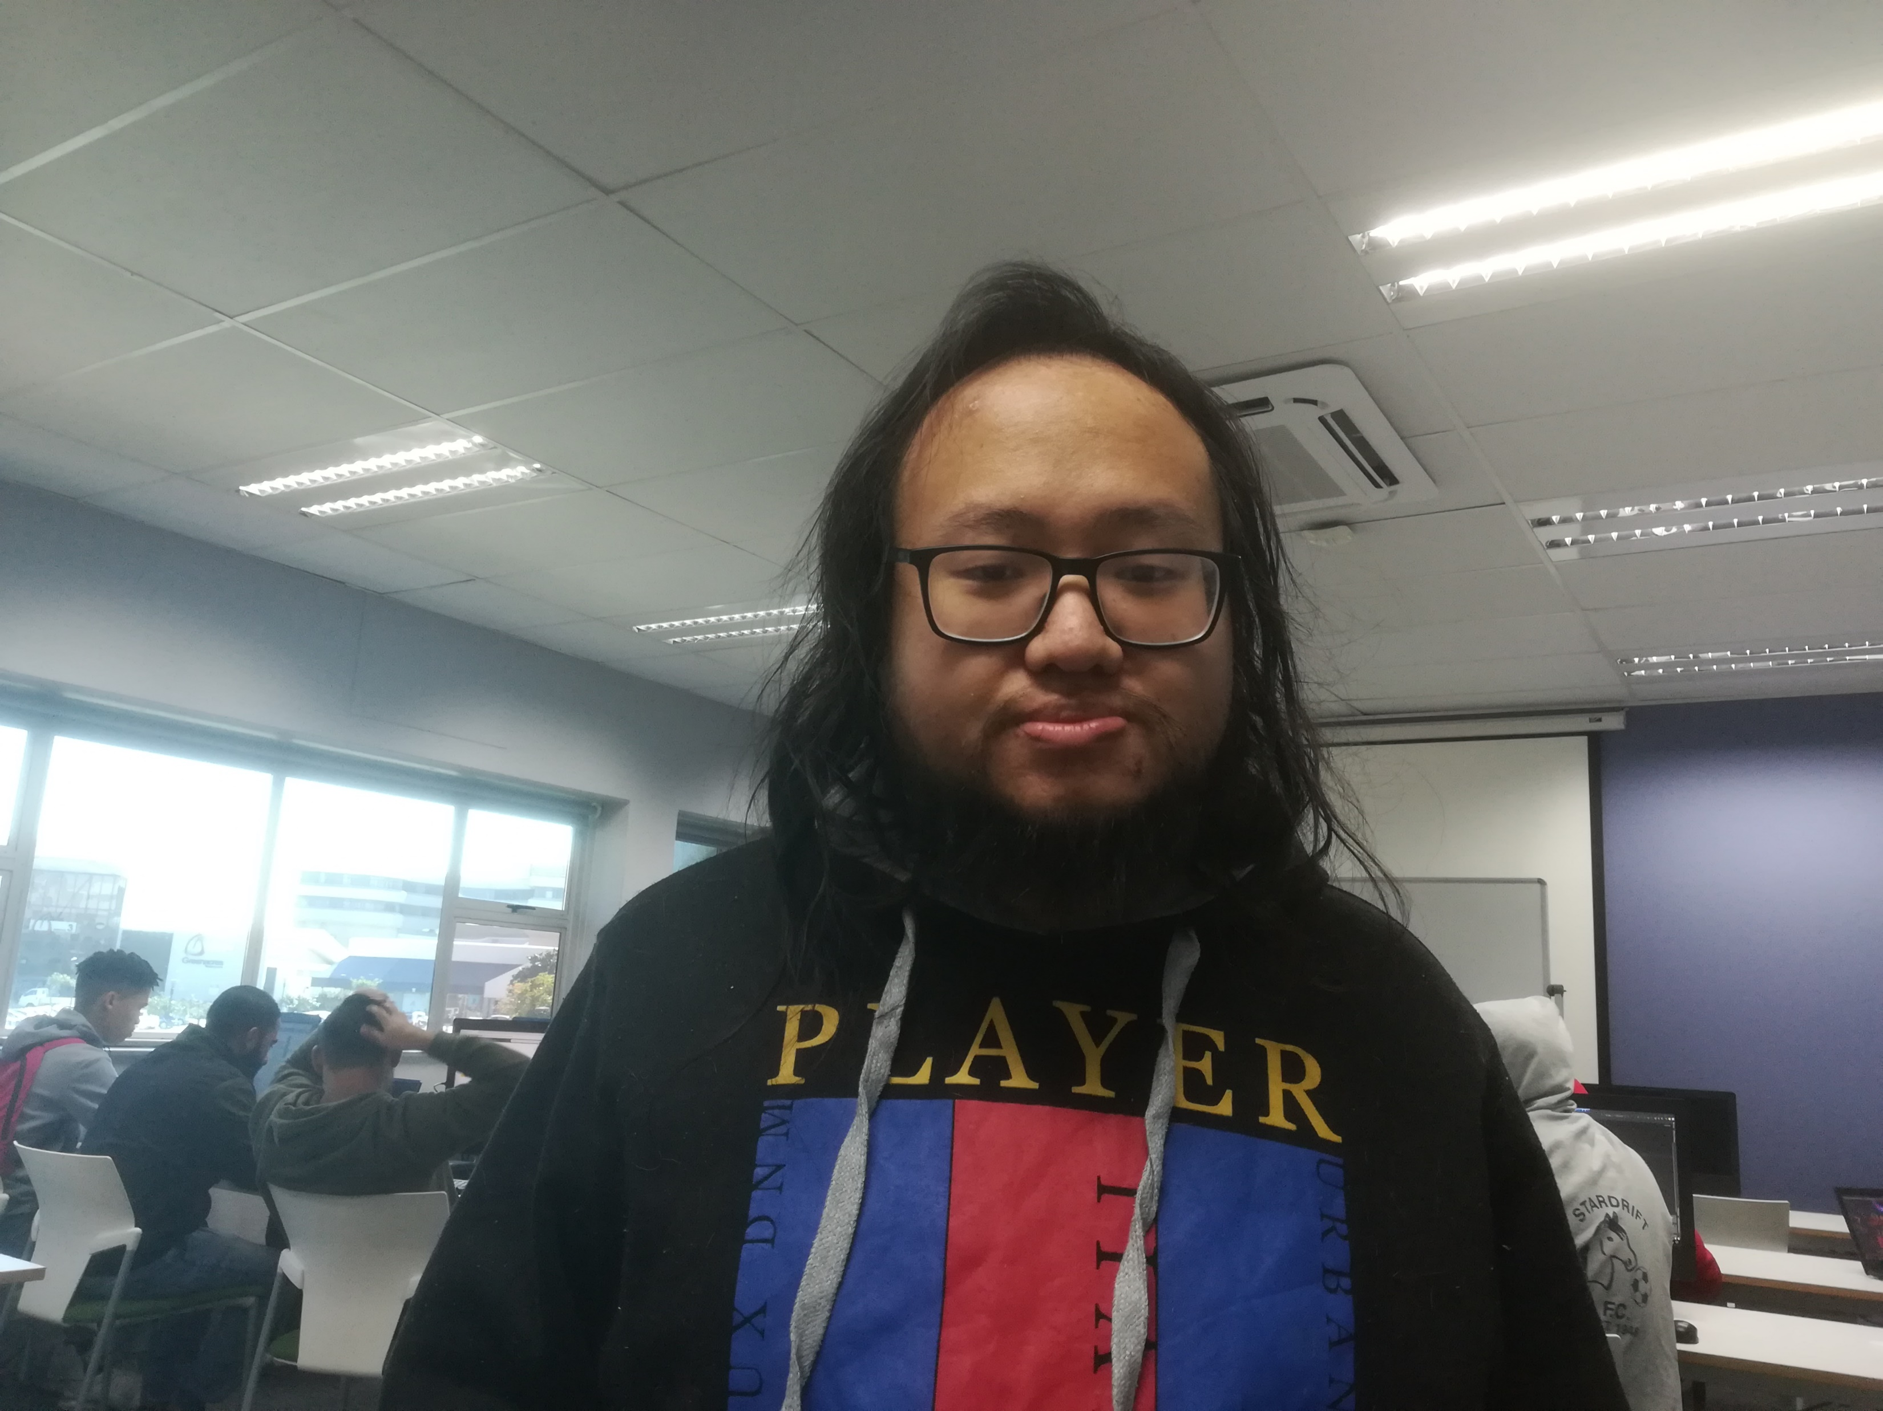
OUR MEMBERS
Magcinonke Crosby Maweyi
Franklyn Heinrich Pedro
AGE: XXX
SEX: XX
DOB: XX-XXX
ADDRESS: XX
PHONE: XXXX
Raphael Son Hing
AGE: XXX
SEX: XX
DOB: XX-XXX
ADDRESS: XX
PHONE: XXXX
Introducing our team members…
AGE: XXX
SEX: XX
DOB: XX-XXX
ADDRESS: XX
PHONE: XXXX
UI Design
ghjjjjjjjjj
UI Design
Main Programmer
Financial Manager

Slide 3
INTRODUCTION
Greetings, today, we will like to represent our organization called Blue Horizon.
As of recently we have been tasked with Cargo fleet with the construction of a program, one that takes records of various information and data of a transportation network and allows further modification and organization in a manageable manner.
And thus, we our efforts will be to construct a program that befits such a opportunity to manifest our efforts into this application.
Who we are and our goals…

Slide 4
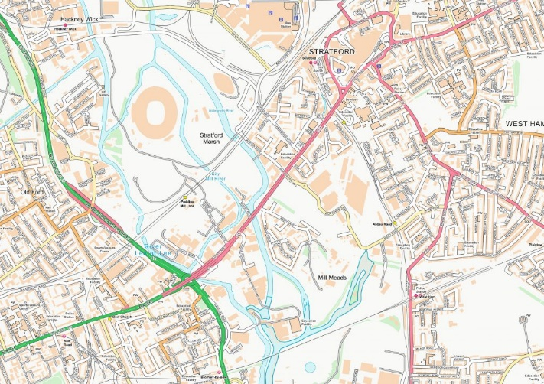


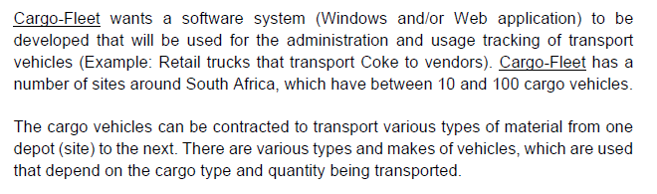
Furthermore, we have divulged further and have summarized other potential issues..
PROBLEM DOMAIN
The current system causes several errors on a daily basis.
Firstly we present an excerpt from the instructional documents.
To much time daily is consumed correcting for errors allotting to 3 or more hours per on average for office employees.
We maintain a strict schedule…
Costs are too high and a more efficient method is being researched.

Slide 5


SWOT
Strengths
User-Friendly
Regular updates
Weakness
Cannot process unrelated information
Requires internet connection
Incompatible devices may not work
Screenshots of the app…
Designs are may be subject to change in the future…
Opportunities
This app is currently in demand
Iconic
Threats
Competitive Apps
New technology may outdate or app

Slide 6
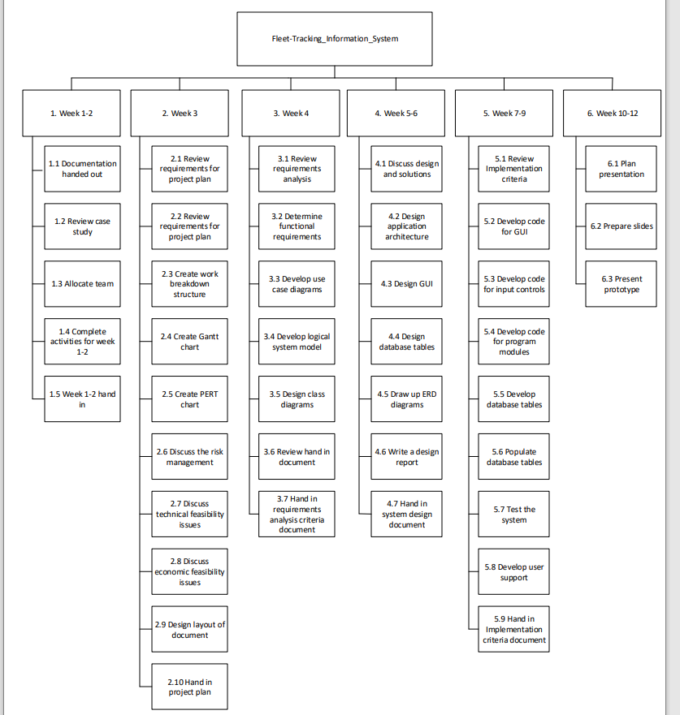
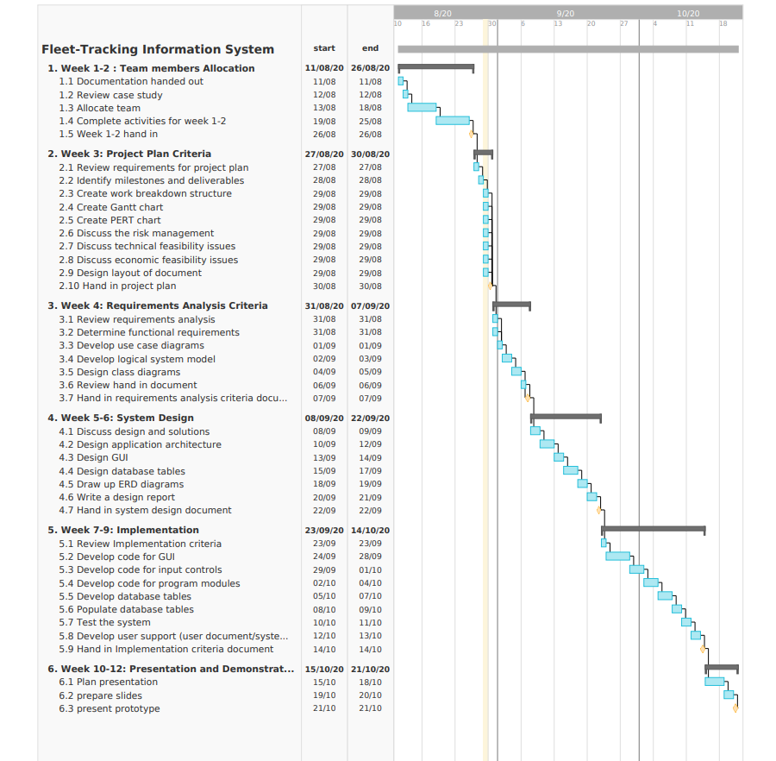
MILESTONES
Hoping to establish beneficial relations that can cooperate again in the future…

Slide 7
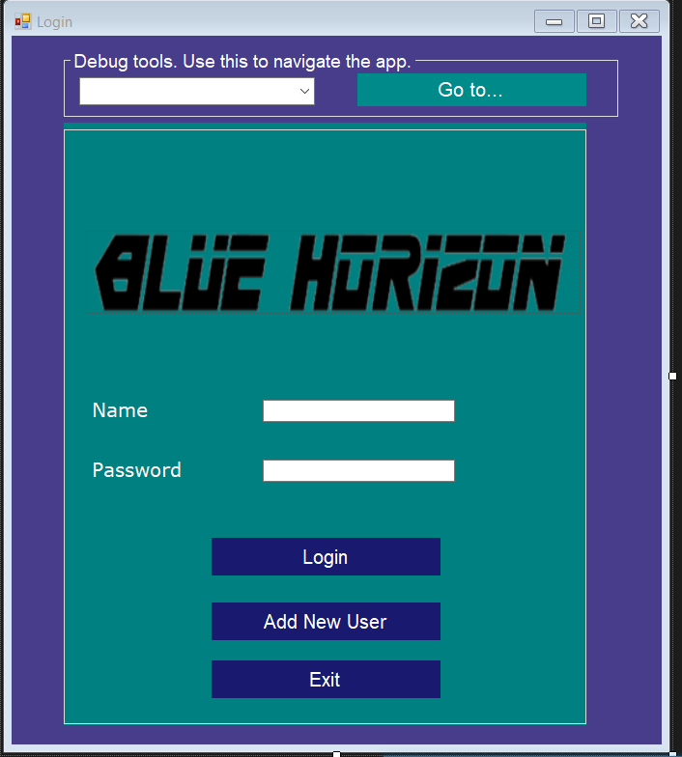
LOGIN and REGISTER
As typical of all sites, we present to you our login and register option.
With this we can welcome new users or authenticate an existing one.
A password identification exclusive to the user must be coded in before access to the other options to the program.
Of course, for newcomers, simply press the new user option, and your information will be recorded into the database, which upon then you can use to login in thereafter.
The standard login and register options..

Slide 8
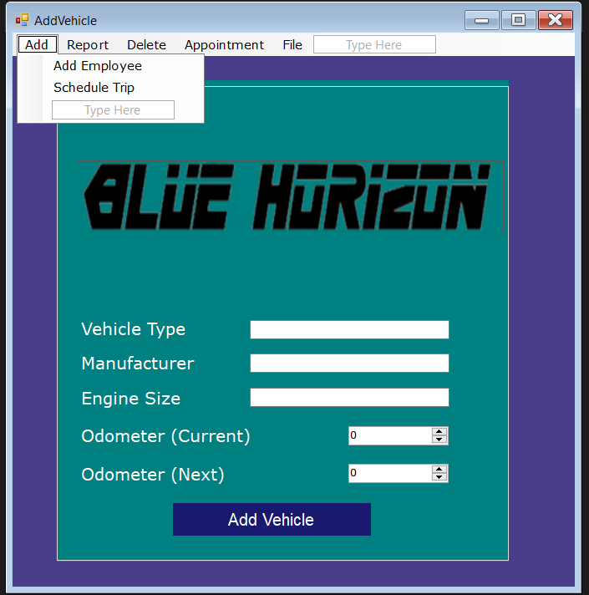
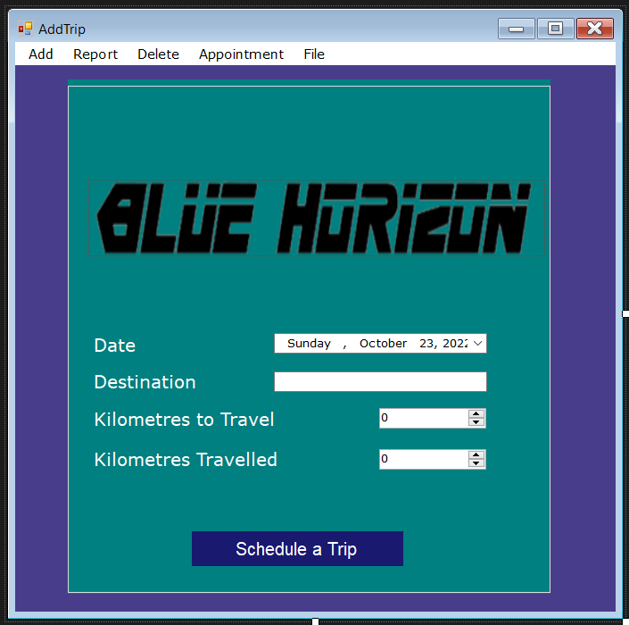
ADD trip, vehicles, employees
Our main feature of this application. The ability to quickly add relevant information to a database in a concise and easy to understand manner,
There are various options to this feature, accessed via drop down menu. This include options to add information about trip, vehicles and employees.
One selected, prompts will occupy the UI of the selected variable. Simply input the required data and confirm to add the information to the database.
The main strength of this operation is that the components are brought into the infertile state allowing users to impress the information efficiently.
Adding records to the database

Slide 9
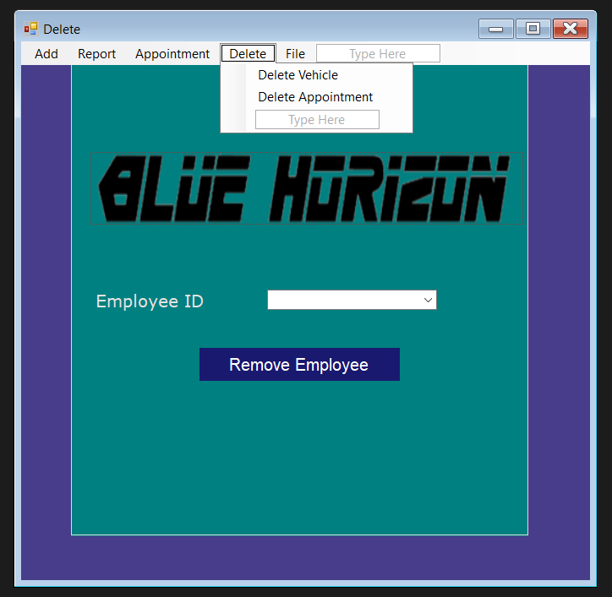
REMOVE trip, vehicles, employees
Sometimes accidents happen.
Perhaps, a simple misclick and incorrect information is uploaded.
In preparation for such an event, we have included this feature.
Similiter to inputting data, there are drop-drop selection for various categories.
By selecting one of them and navigating the correct record, either by input a code or via drop down menu, we can remove the information from the database,.
Removing mistaken records.

Slide 10
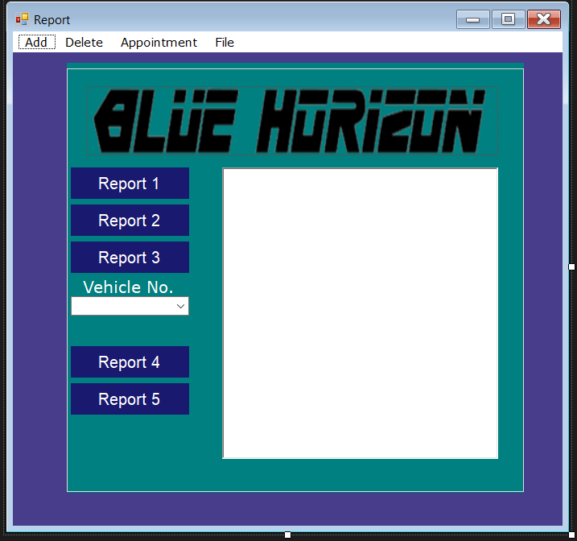
REPORTS
With all this data collected, there of course must be an outlet to display it.
The report section categories relevant information and The report section provides a display of all the information provided.
All the information is summarized and the user can browse the records at their leisure.
This is the lead up of all the various functions of the app.
Dispay all the information

Slide 11
In this section we conclude our phase for planning how to operate our ap.p It has been a tough journey where we had to specify how our app should be built according to our preferred way to serve our customers with their full.
We thank you for your learning about our demonstration and for your patience and understanding…
CONCLUSION

Slide 12


Slide 13
